Slide 1
Approximating solutions to boundary-value problems

Slide 2
Introduction
In this topic, we will
  Describe what will be covered in the next topic
    Approximating solutions to boundary-value problems (bvps)
  Review how a bvp differs from an initial-value problem
  Describe Dirichlet and Neumann boundary conditions
  Give a description of linear ordinary differential equations
  Introduce the following two topics

Slide 3
Solutions to equations
In your calculus course, you have been introduced to:
  Initial-value problems (ivps)
  Boundary-value problems (bvps)
A 2nd-order bvps involves a 2nd-order ordinary differential equation (ode) and two conditions at two different points
  Generally, we are looking for a solution as a function of space,
  so we will use a function u(x) and not y(t)
  The constraints or conditions will be specified at two points:
  x = a and x = b
The conditions for a bvp can include:
  Fixed or Dirichlet conditions
  Neumann conditions

Slide 4
Dirichlet boundary conditions
The most common boundary conditions are fixed or Dirichlet boundary conditions:
u(a) = u_{a}
u(b) = u_{b}
  These specify the value of the function at two different points

Slide 5
Neumann boundary conditions
Alternatively, we may specify the derivative at one of the boundary points
  Such a condition is described as a Neumann boundary condition
  If the derivative is zero, this indicates an insulated boundary:
  A non-zero derivative may model a boundary point that dissipates power at a known rate

Slide 6
What is an insulated boundary?
Why does a zero derivative imply an insulated boundary?
  If your hand is 10 cm from a block of ice,
  you expect it to get colder if you move closer to it
  If your hand is 10 cm from a source of heat,
  you expect it to get warmer if you move closer to it
  If your hand is 10 cm from an insulated wall,
  you don’t expect the temperature to change greatly if you move it closer to that wall

Slide 7
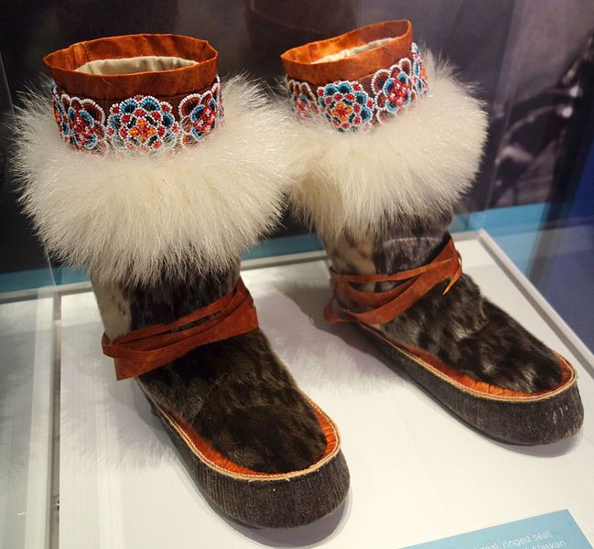
What is an insulated boundary?
An example: mukluks
User: Daderot

Slide 8
Looking ahead
We shall see two techniques:
  The shooting method
  Finite-difference method
There is an additional third technique:
  The finite element method
We’ll discuss the first two, and introduce the third

Slide 9
Definitions
A 2nd-order linear ordinary differential equation (lode) is one that is linear in the unknown function and its derivatives
  The coefficients and right-hand side can be functions of x
  If the forcing function is 0, we call it a homogenous lode:
  If the coefficients are constant, lode with constant coefficients:
    The forcing function need not be constant
  Of course, we can have a homogenous lode with constant coefficients:

Slide 10
Linear and non-linear equations
In your calculus course, the only problems you are able to easily solve are those with constant coefficients
However, if an ode is not a lode, it can still, in general, be described in the form

Slide 11
Looking ahead
The shooting method will work on an arbitrary 2nd-order ode
The finite-difference method will only work for lodes
  The techniques we see for the second will lead us to techniques we will use in approximating solutions to partial-differential equations
    Specifically, Laplace’s equation, the heat-conduction equation and the wave equation

Slide 12
Summary
Following this topic, you now
  Have an overview of the ideas to be covered in this sub-section
  Understand the difference between Dirichlet and Neumann boundary conditions as well as the concept of an insulated boundary condition
  Are aware of the two techniques we will consider
  Understand the definitions of linear odes and lodes with constant coefficients as well as the concept of a homogenous lode

Slide 13
References
[1] https://en.wikipedia.org/wiki/Boundary_value_problem

Slide 14
Acknowledgments
None so far.

Slide 15



Colophon
These slides were prepared using the Cambria typeface. Mathematical equations use Times New Roman, and source code is presented using Consolas. Mathematical equations are prepared in MathType by Design Science, Inc.
Examples may be formulated and checked using Maple by Maplesoft, Inc.
The photographs of flowers and a monarch butter appearing on the title slide and accenting the top of each other slide were taken at the Royal Botanical Gardens in October of 2017 by Douglas Wilhelm Harder. Please see
https://www.rbg.ca/
for more information.

Slide 16
Disclaimer
These slides are provided for the ece 204 Numerical methods course taught at the University of Waterloo. The material in it reflects the author’s best judgment in light of the information available to them at the time of preparation. Any reliance on these course slides by any party for any other purpose are the responsibility of such parties. The authors accept no responsibility for damages, if any, suffered by any party as a result of decisions made or actions based on these course slides for any other purpose than that for which it was intended.

